Slide 1


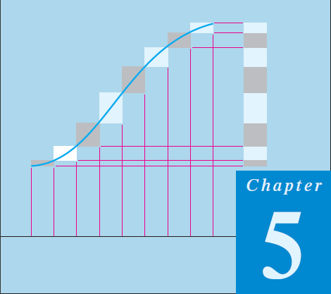
Thomas Calculus 11th
08
Integration Techniques 01
Samuel Lukas

Slide 2
Agenda
Integration Principle
Basic Integration Formulas
Integration by Parts
Integration of Rational Functions
Trigonometric Integrals
Trigonometric Substitutions
The Substitution Z = tan(x/2)
Improper Integrals

Slide 3





Integration by Parts

Slide 4
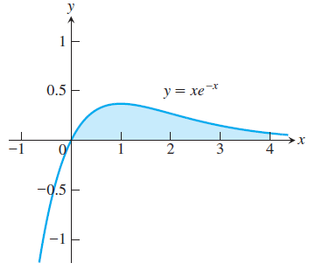




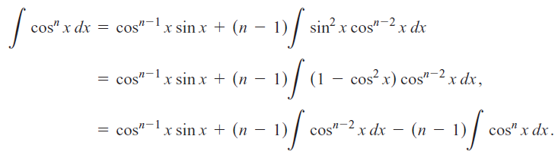


Slide 5



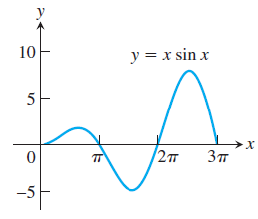
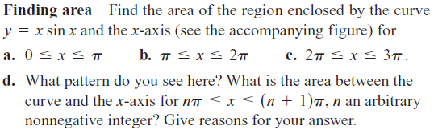
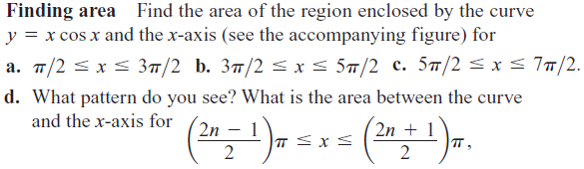
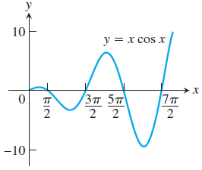
Exercises
01
02
03
04
05

Slide 6








Proving these formulas
06
07
08
09
10
11
12
13

Slide 7
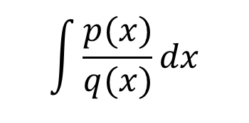
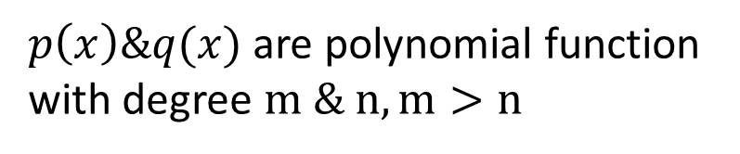
Integration of Rational Functions
$$\int{\frac{p(x)}{q(x)}dx}$$
$p\left(x\right)\&q(x)$ are polynomial function
with degree $m \& n, m>n$
(1)
(2)
(3)
(4)

Slide 8









Examples

Slide 9








Others Examples

Slide 10














Exercises
01
02
03
04
05
06
07
08
09
10
11
12
13
14

Slide 11
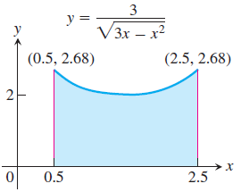
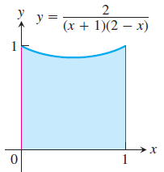
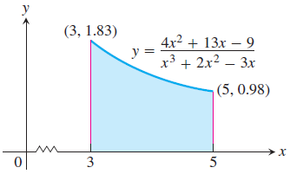
In Exercises 15 and17, find the volume of the solid generated by revolving
the shaded region about the indicated axis.
15
x axis
16
y axis
Find the x-coordinate of the centroid of this region to two decimal places.
17

Slide 12


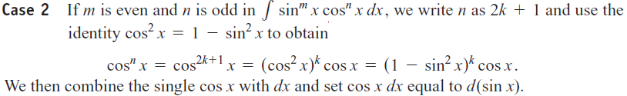

Trigonometric Integrals

Slide 13















m is Odd
m is Even and n is Odd
m and n are Both Even

Slide 14















Slide 15















Exercises
01
02
03
04
05
06
07
08
09
10
11
12
13
14
15

